Slide 1

Greater Cleveland Superintendent Association
June 9, 2020

Slide 2

The Latest from OBM…
State tax collections $271.3 million below projections in May
  Sales Taxes $167 million below estimates
  Income taxes $91.3 million below estimates
Shortfall for 2020 almost $1 billion with one month to go
The Rain Day Fund ($2.7 billion)...not yet!
  FY ‘20 spending cuts
  Enhanced federal medical funding approved by Congress

Slide 3
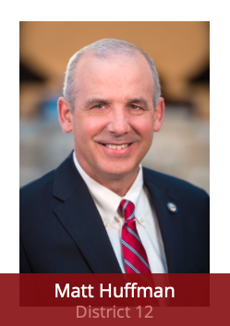
Senate Bill 319
Permit high school students to use final course grades in lieu of the corresponding end-of-course exam if that exam was not administered in the 2019-20 school year
Provide temporary furlough authority for school districts
  Effects bargaining would be needed
  Insurance and use of paid days
  Check your negotiated agreement for interim bargaining language

Slide 4
Senate Bill 319
Maintain the Third-Grade Reading Guarantee cut score for the 2020-21 school year at the level set for the 2019-20 school year
Temporarily removing required qualifications for teachers who are assigned to provide intense remediation reading assistance in the 2020-21 school year
Exempt districts from the requirement to implement reading and improvement monitoring plans for the 2020-21 school year based on test results from the 2019-20 school year

Slide 5
Senate Bill 319
Permit certain state-licensed individuals to provide services electronically to students with disabilities through the 2020-21 school year
Incorporate SB 313 and House Bill 651, which provide an additional state payment to certain school districts that experienced a sizeable decrease in Public Utility Tangible Personal Property values

Slide 6
Senate Bill 319
Require the Ohio Department of Education to develop on online, 30-day training program to satisfy the classroom portion of pre-service and annual in-service training for school bus driver certification for the 2020-21 school year only

Slide 7
BASA’s Proposed Amendments to SB 319
Extend HB 197’s hold harmless provisions related to report cards and results, such as voucher and community school eligibility, ADCs, etc., through school years 2020-21 and 2021-22
Give school districts the flexibility to decide locally whether or not to grant the use of their buildings to outside groups

Slide 8
BASA’s Proposed Amendments to SB 319
Extend HB 197’s flexibility to make local decisions regarding student promotion through school years 2020-21 and 2021-22 as requested
Transportation flexibility:
  Exempt school districts and educational service centers from prohibitions against reductions in student transportation services at any point in the school year (ORC 3327.015);
  Permit districts to use buses for any purpose necessary for the district’s operations, including delivery of meals, technology, and curriculum materials;
  Provide relief and flexibility to school districts in transporting students in chartered nonpublic, community, and STEM schools

Slide 9
BASA’s Proposed Amendments to SB 319
Extend the moratorium on the requirement for districts to install storm shelters
Repeal the school district territory transfer provision

Slide 10
And Then Comes Senate Bill 320…
The Board of Education determines:
  If and when their buildings will be open for instruction with students in attendance
  What safety measures will be taken
  If and when buildings are closed down

Slide 11
And Then Comes Senate Bill 320…
“No other public official shall prohibit a district or school from opening its school buildings for instruction with students in attendance, cause a district or school to close its school buildings, or require the district or school to adopt health safety measures and guidelines to address COVID-19”

Slide 12
And Then Comes Senate Bill 320…
Parents:
  May determine whether the building has adequate safety measures to address COVID-19
  No public official shall prohibit a parent from providing instruction in a particular building because of the implications of COVID-19
  No public official shall require a parent to adopt health safety measures and guidelines to address COVID-19

Slide 13
In Other News…

Slide 14
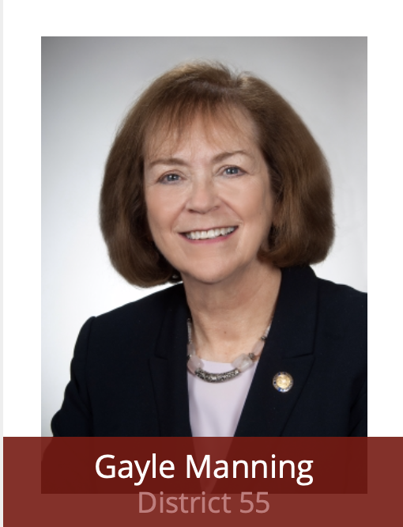
HB 123—School Security/Suicide Awareness
Anonymous Reporting Program
  First year after bill’s effective date
School Threat Assessment Team
  Second year after bill’s effective date
Training Programs in Suicide Awareness and Prevention and Social Inclusion
  “Next school year” after at least two years after effective date
Student-Led Violence Prevention Clubs
Emergency Management Plans
  Overseen by Department of Public Safety

Slide 15
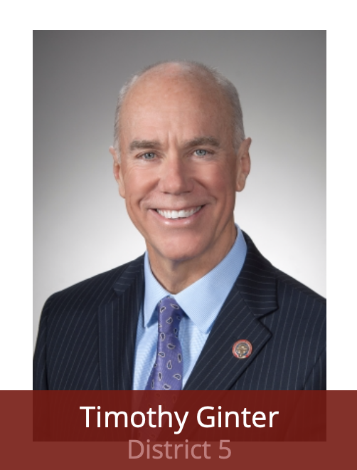
HB 164—Student Religious Expression
“Ohio Student Religious Liberties Act of 2019.”
Requires public schools to give students who wish to meet for the purpose of religious expression the same access to school facilities given to secular student groups, without regard to the content of the expression.

Slide 16
HB 164—Student Religious Expression
Removes a current provision that permits a school district to limit the exercise or expression of religion to lunch periods or other noninstructional time periods.
Prohibits public schools from restricting a student from engaging in religious expression in the completion of homework, artwork, or other assignments.
Prohibits public schools from rewarding or penalizing a student based on the religious content of the student’s homework, artwork, or other assignments.

Slide 17

HB 322—Teacher Residency Program
Reduces the Ohio Teacher Residency (OTR) program to two years from four
Eliminates measures of progression, including completion of the performance-based assessment prescribed by the State Board of Education during a participant’s third year, as a required component of the program

Slide 18
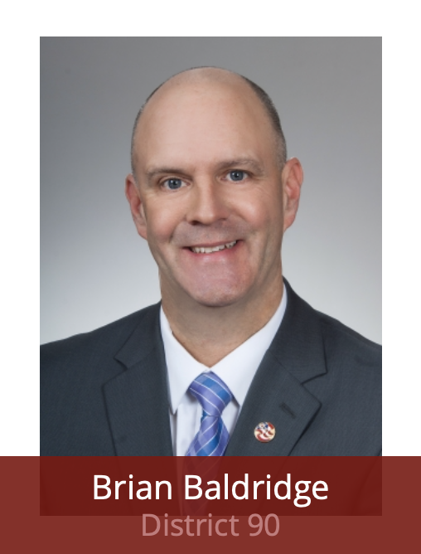
HB 436—Dyslexia Screening and Services
Requires the Department of Education, in collaboration with the International Dyslexia Association in Ohio, to establish the Ohio Dyslexia Committee (ODC)
Requires school districts to administer annual dyslexia screenings
Requires each teacher who provides instruction for students in grades K-1 and those providing special education instruction for students in grades 4-12 to complete a professional development course by the beginning of the 2020-2021 school year
Requires each school district and all other public schools, beginning in the 2020-2021 school year, to establish a structured literacy certification process for teachers in grades K-3

Slide 19
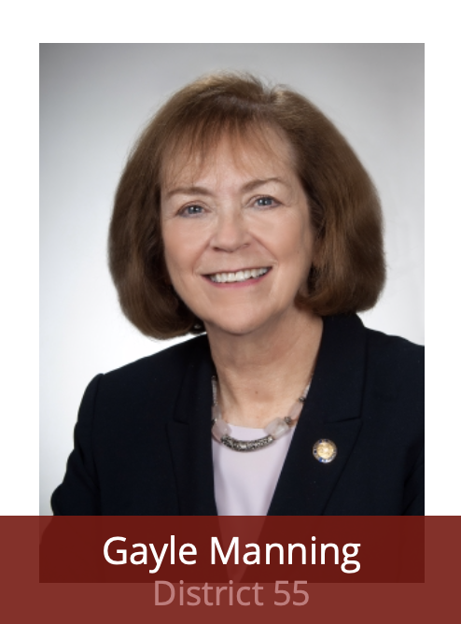
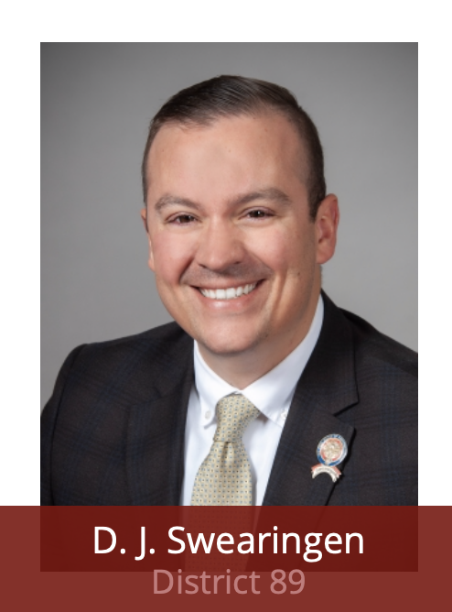
HB 693—Beginning the School Year
No school may begin the 2020-21 school year before Wednesday, September 9, 2020

Slide 20
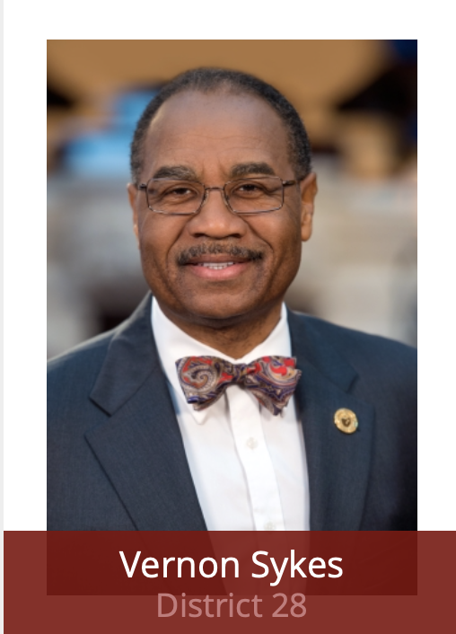
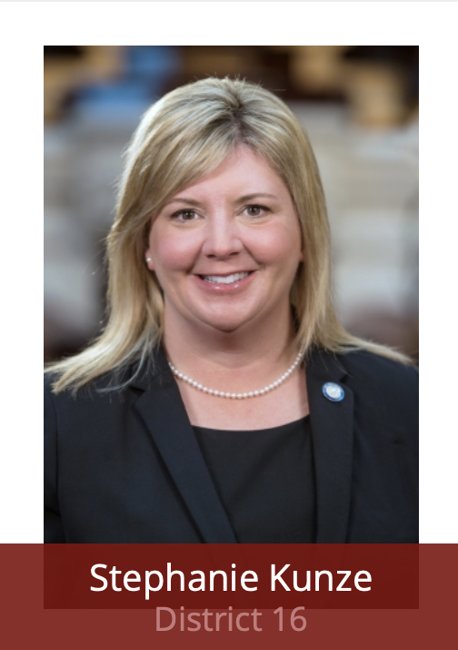
SB 121—Health Standards
Removes the requirement of the adoption of a concurrent resolution when adopting or revising state standards or curriculum for health education.
Requires the adoption or a concurrent resolution when adopting or revising state standards for venereal disease education.
Requires the State Board of Education to develop and adopt health education standards for grades K-12 health education.

Slide 21
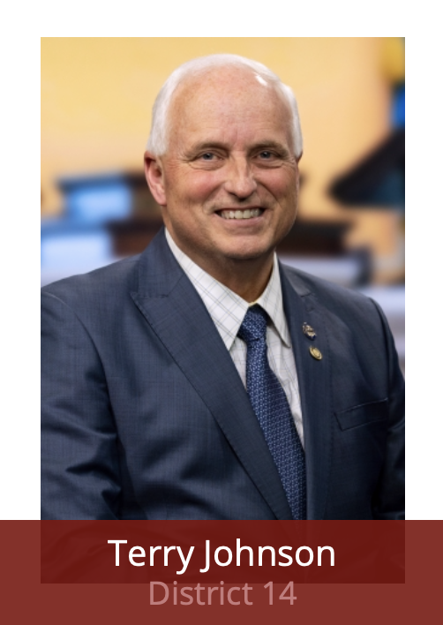
SB 313—Public Utility Devaluations
Requires the Department of Education to make a payment to each school district with more than a 10% decrease in the taxable value of utility tangible personal property (TPP) subject to taxation between tax years 2017 and 2019 (for the FY 2020 payment) or tax years 2017 and 2020 (for the FY 2021 payment)

Slide 22
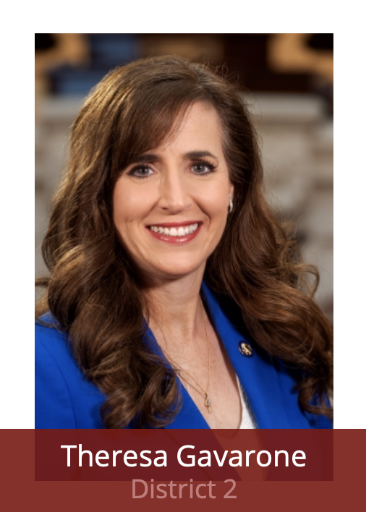
SB 288
Student Religious Expression in Extra-Curricular Activities
Prohibits a public or nonpublic school or an interscholastic athletics conference or organization from adopting a rule, bylaw, or other regulation that prohibits or creates an obstruction to wearing religious apparel when competing or participating in interscholastic athletics or extracurricular activities.

Slide 23
Vouchers
2020-2021 eligibility list of 1,227 buildings is halted
Vouchers eligibility for 2020-2021 is instead based on the current 2019-2020 eligibility list of 517 buildings
Application window began April 1 and runs for 6o days
  ODE Re-opening window July 1 for rolling application period
Applications for 2021-2022 list are open on February 1, 2021
Income-based vouchers are unaffected

Slide 24
ODE Timelines
Distance Learning
  Hearing that this will be pushed to November
Blizzard Bag
  July 1 Waiver

