Slide 1

BASA Update
June 2026

Slide 2
Equipping our Members
  BASA Mentoring Program
  BASA New Superintendent Program

Slide 3
Get Involved
Three Tips for Every BASA Member
Attend Fall Conference
Attend Regionals
Join 1 or 2 Committees

Slide 4
BASA Contract Assistance
Model Contract
Compensation comps for your region
Contract Length
Contract Language
Superintendent Evaluation
Per diem compensation
Retirement (STRS)
Retire/Rehire
Final Legal Review

Slide 5



THANK
YOU

Slide 6
Legislative Update
June 2026

Slide 7

Overview of GRF Revenues through April 2026

Slide 8
April 2026 Bottom Line
Plus $1.293 Billion
Total GRF revenues were $1.049 billion ahead of projections for the first ten months of the fiscal year
GRF expenditures were $245 million below estimates for the first ten months of the fiscal year
*Source – OEPI - Dr. Howard Fleeter

Slide 9
Updates

Slide 10


Slide 11



Slide 12



Slide 13
SJR 10 – Voter ID
Sens. Timken (R) & Gavarone (R)
Proposes an amendment to the Ohio Constitution to appear on the ballot in November 2026, to require electors to provide identification (ID) in order to vote.
Requires an elector to show photo ID when voting in person, provided that the General Assembly may allow an exception for those with a sincere religious objection to being photographed, as under the existing statute.
Defines “photo identification” to include the same documents as are currently acceptable under the Revised Code.
Allows the General Assembly to choose whether to require photo ID to vote by mail or to permit the use of a signature and certain nonphoto ID, as the statute currently does.

Slide 14
Bills Awaiting Governor’s Signature

Slide 15
HB 455 – Deregulation Bill
Reps. Manning (R) & Bird (R)
Revises or eliminates a series of programs, requirements, and provisions related to the Department of Education and Workforce and public and chartered nonpublic schools.
Revises the performance measures used to calculate performance ratings for the state report card’s Graduation and the College, Career, Workforce, and Military Readiness components.
Eliminates obsolete provisions regarding the state report card and state assessments.
Updates the graduation rate measure to properly count IEP students who defer diplomas as graduates if they have met all requirements

Slide 16
HB 455 – Deregulation Bill
Reps. Manning (R) & Bird (R)
State Board of Education
Increases the number of appointed State Board of Education members from five to seven.
Requires each member appointed to an office that is vacant as of January 1, 2027, to be
appointed by that date and have a term of office beginning on that date.
Requires at least one State Board member to have experience as a representative for a
rural, suburban, and urban school district, a community school, and a chartered nonpublic
school.
Requires the State Board to add additional grade levels to certain alternative resident
educator license holders’ licenses to authorize the educator to provide instruction at any
grade from pre-kindergarten to 12 or combination of grades as assigned by the educator’s
employing school district based on local staffing needs.

Slide 17
HB 455 – Deregulation Bill
Reps. Manning (R) & Bird (R)
Department of Education and Workforce
Removes a provision that would eliminate, as a performance measure for the Early
Literacy component, the percentage of students who are promoted based on their scores
on the third grade English Language Arts achievement assessment or an alternative
assessment, and replaces it with the percentage of students who are not subject to
retention under the Third-Grade Reading Guarantee.
Requires the Department of Education and Workforce to develop a list of approved
training courses in the Science of Reading that are more rigorous than the Department’s
refresher competency-based training course.
Permits licensed educators to take the more rigorous course from the list in place of the
Department’s refresher course.

Slide 18
HB 455 – Deregulation Bill
Reps. Manning (R) & Bird (R)
Districts and Schools
Prohibits the removal of a member of a school district board of education or ESC
governing board for absence without a sufficient if the reason is that the person is an
active or reserve member of the U.S. Armed Forces or the Ohio National Guard and is
deployed outside the territory of the district or ESC.
Removes a provision that exempts educational service center governing boards from the
prohibition on a board of education spending more than 15% of the board’s annual
operating budget on administrative costs (an identical provision was enacted by H.B. 184
of the 136th General Assembly, effective March 20, 2026).
Revises the automatic closure criteria for community schools.

Slide 19
HB 455 – Deregulation Bill
Reps. Manning (R) & Bird (R)
Other Items
Eliminates a provision that declares that a grant awarded under the Early Childhood
Education Grant Program is not considered publicly funded childcare or a family services
program (an identical provision was enacted by H.B. 184 of the 136th General Assembly,
effective March 20, 2026).
Eliminates a provision that permits the ESC providing student transportation to and from
school under the Montgomery County Pupil Transportation Pilot Program to also provide
transportation to and from a student’s workplace learning experience (an identical
provision was enacted by H.B. 184 of the 136th General Assembly, effective March 20,
2026).
Allows a 14- or 15-year-old to be employed between 7:00 p.m. and 9:00 p.m. any night
preceding a day school is not in session if the minor has approval to do so from a parent
or legal guardian.

Slide 20
SB 276– Interstate Compact
Sen. Roegner (R)
Interstate Compact for School Psychologists
Enters Ohio into the Interstate Compact for School Psychologists to improve public access
to school psychological services by facilitating the interstate practice of school psychology
in educational or school settings.
Success sequence curriculum
Requires the Department of Education and Workforce to review and maintain a list of
curriculum for the success sequence for grades 6-12.
Requires school districts to provide instruction on the success sequence in at least one
course required for high school graduation.

Slide 21
SB 276– Interstate Compact
Sen. Roegner (R)
Student Athlete Mobility (SAM) Act
Requires the governing body of a public high school to which the bill applies to adopt a
policy that permits a student enrolled in a neighboring public high school that does not
offer an extracurricular activity to petition to participate in that activity at its high school.
Applies the bill to each public high school that (1) offers an extracurricular activity and
(2) is a member of an organization that regulates interscholastic athletics.
Hybrid assessment report
Requires the Department of Education and Workforce, by November 15, 2026, to submit
a report to the House and Senate Education committees about a single, statewide hybrid
assessment system that provides both criterion-referenced results aligned to state
academic standards and nationally norm-referenced results.

Slide 22
HB 3 – School Bus Safety Act
Reps. Willis (R) and Thomas (R)
School Bus Safety Fund and Grant Program
Creates the School Bus Safety Fund in the state treasury, consisting of the criminal fines
and a portion of the civil penalties collected for violations of passing a stopped school bus.
Requires the Director of Education and Workforce to administer the fund and use the
money in it to make grants to school districts to improve the safety features on school
buses through the School Bus Safety Grant Program, which is created by the bill.
Appropriates $10 million in FY 2026 from State Lottery funds towards the School Bus
Safety Grant Program.
Public education on school bus safety
Requires DPS, especially through the Bureau of Motor Vehicles (BMV), to require the
display of graphics about school bus safety and the laws related to it at deputy registrar
offices and on its websites.

Slide 23
HB 3 – School Bus Safety Act
Reps. Willis (R) and Thomas (R)
Criminal penalties for illegally passing a stopped school bus
Increases the criminal penalties for illegally passing a stopped school bus that is loading
or unloading passengers by setting required minimum fines, increasing the maximum
fines, increasing the length of the driver’s license suspension, and imposing higher
penalties and points on a driver’s license for repeat offenders.
Requires all repeat offenders to attend and successfully complete a school bus safety
course, developed by the Director of Public Safety, and authorizes first-time offenders to
take the course to lower their fine and waive the imposition of points on their license.

Slide 24
SB 19 – Intervention Plans
Sen. Brenner (R)
Diagnostic assessments
Requires the Department to approve a list of up to six reading diagnostic
assessments for grades K-3, and on the bill’s effective date, add a sixth diagnostic to the
approved list of math diagnostic assessments.
Requires that additional assessment to be the one that scored the sixth highest in the
Department’s most recent evaluation of diagnostic assessments (iReady Math)
Prohibits a school district, community school, or STEM school from administering
diagnostic assessments from multiple providers in reading or math to the same student
in grades K-3 unless certain criteria apply, and to receive higher ratings on the state report
card.
Permits a public school that has a contract that existed prior to September 30, 2025, with
a provider for a reading diagnostic assessment approved by the Department prior to that
date to continue to use that provider’s diagnostic assessment.

Slide 25
SB 19 – Intervention Plans
Sen. Brenner (R)
Academic intervention services and math improvement
Requires each district or school to provide evidence-based academic intervention
services, free of cost, to students who demonstrate a limited level of skill in either a
prescribed state diagnostic assessment or a state assessment, in math, English language
arts, or both subject areas.
Beginning with the 2026-2027 school year, requires each district or school to develop a
math achievement improvement plan if 51% or less of a building’s or school’s students
who took the third grade math achievement assessment attained at least a proficient
score on the assessment.
Beginning with the 2027-2028 school year, and each school year thereafter, requires the
Department of Education and Workforce to randomly select 5% of districts and schools
for a review of their academic intervention services.

Slide 26
SB 19 – Intervention Plans
Sen. Brenner (R)
Math and reading curricula, instructional materials, and
intervention
Requires the Department to, by April 15, 2027, review core math curricula and establish
a list of high-quality core curriculum and instructional materials in math and a list of
evidence-based math intervention programs, that are aligned with state standards and
best practices.
Requires the Department to establish a rubric and scoring system to evaluate core math
and English language arts curricula based upon whether or the extent to which a
curriculum facilitates a student’s skill building and sequential advancement through
mastery.
Requires the Department to include in a school building’s state report card as nongraded
data the reading and math curricula used in the building and whether the curriculum is
designated as high-quality by the Department.

Slide 27
SB 19 – Intervention Plans
Sen. Brenner (R)
Advanced learning opportunities in math
Requires districts to do the following for the 27/28 school year:
Enroll each qualifying student in sixth grade in a math course in seventh grade that
combines in one school year seventh- and eighth-grade math standards and in Algebra
I in the eighth grade;
Enroll each qualifying student in grades 3-5 in advanced learning opportunities in
math; and
Adopt a comprehensive math placement and promotion policy.

Slide 28
SB 19 – Intervention Plans
Sen. Brenner (R)
Qualifies for automatic enrollment in advanced math courses or advanced learning
opportunities each student who meets a school’s choice of multiple measures under one
of the following:
The student achieves an accomplished level of skill on a math achievement
assessment and the student holds an average class grade of “A” or “B” in a math
course;
The student achieves a designated score, as determined by the Department, on a
math diagnostic assessment and an accomplished level of skill on a math achievement
assessment.
Requires the Department to adopt rules regarding the placement of students in an
advanced math course and, not later than 90 days after the bill’s effective date, designate
a score that reflects an accomplished level of skill on a math diagnostic assessment.
Permits each public school to provide additional students advanced math learning
opportunities.

Slide 29
SB 19 – Intervention Plans
Sen. Brenner (R)
Math teacher proficiency and professional development
Requires the Department to develop a professional development course focusing on
foundational knowledge in math and integrates life skills and, by December 31, 2026,
develop a pilot series of professional development programs for school and regional
educational leaders on evidence-based math instruction.
Requires the State Board of Education to assess the math proficiency of each applicant
for a new valid educator license with a pre-K-8 grade band and who may be assigned to
teach math.
Career-technical education for home-educated students
Permits a home-educated student to participate in the career-technical education
programs of the student’s resident school district as a part-time student without any
financial assessment, charge, or tuition that is not charged to a public school student and
requires such a student to be counted in the district’s enrolled ADM.

Slide 30
SB 19 – Intervention Plans
Sen. Brenner (R)
Autism scholarship program
Qualifies for the Autism scholarship program a child who has been diagnosed as autistic
by a physician or psychologist, is enrolled in a chartered or nonchartered nonpublic
school, is home educated, or is a student older than compulsory school age and less than
22 years of age and received a home education and has not received a diploma, and has
an education plan developed by the school district in which the child is entitled to attend
school that includes transitional services.
Patriotic youth organizations
Requires a school district, at the request of certain federally recognized youth
organizations, to permit a representative of that organization to speak with and distribute
informational materials to students during school hours for up to ten minutes during the
school day at least once per school year.

Slide 31
HB 479 – Budget Corrections
Rep. Schmidt (R)
Expedited Local Partnership Program
Requires the Facilities Construction Commission (FCC) to determine a school district’s
portion of the basic project cost for a project under the Expedited Local Partnership
Program (ELPP) based only on the required percentage of the basic project costs,
determined based on the school district’s percentile ranking.
Permits FCC and a qualifying district participating in the ELPP to elect to recalculate the
district’s portion of the basic project cost using the district’s most recent percentile
ranking when the district becomes eligible for assistance under the Classroom Facilities
Assistance Program (CFAP).

Slide 32
HB 479 – Budget Corrections
Rep. Schmidt (R)
Authorizes a fixed-amount, one-year property tax reduction for homestead exemption
recipients.
Reimburses local governments for revenue lost due to the reduction from a portion of
surplus GRF revenue.
Inside millage inflation reduction
Makes several changes to the calculation and administration of a recently enacted
mechanism that limits property tax increases from inside millage to the rate of inflation.
Modifies how the reduction is determined for subdivisions with territory in multiple
counties with different reappraisal years and clarifies that the reduced rate applies
uniformly throughout the district.
Requires the calculation of the school district 20-mill property tax floor to reflect any
reductions made to the district’s inside millage.

Slide 33
HB 479 – Budget Corrections
Rep. Schmidt (R)
Homestead exemption calculation
Modifies the calculation of the homestead exemption by calculating the reduction
without regard to an existing property tax credit for school districts on the 20-mill floor.
Expanded 2027 sales tax holiday
Requires a 15-day sales tax holiday to be held in August 2027 for most items priced under
$500.

Slide 34

Ohio House of Representatives

Slide 35
HB 715 - Voucher Accountability
Reps. Manning & Odioso (R)
Requires the Department of Education and Workforce to annually post for each chartered nonpublic school the school’s total enrollment, the number of scholarship students enrolled in the school, what kind of school each scholarship student attended in the prior school year, and the amount of state support the school received.
Requires the Department to post on its website the number of students participating in a state scholarship program, disaggregated by family income.
Requires the Department to establish a system to permit an individual to compare the performance data of scholarship students enrolled in a chartered nonpublic school with the performance data of similar students enrolled in nearby schools.
Requires the Department to require each EdChoice scholarship applicant to include the school, and if applicable the district, in which the applicant was enrolled for the school year prior to the one for which the applicant is submitting an application.

Slide 36

Ohio Senate

Slide 37
SB 326 – Computer Science
Sens. Cirino (R) & Ingram (D)
Generally requires each student that first enters 9th grade on or after July 1, 2029, to complete one-half unit of instruction in computer science to graduate.
Exempts from that requirement any student who was enrolled in high school in a state
that does not have a computer science requirement before transferring to an Ohio high
school during the student’s senior year.
Permits a student to substitute a computer science for certain other courses and requires the Department of Education and Workforce to develop guidance for those substitutions.
Requires the Department to adopt a list of computer science courses that can be used to satisfy the graduation requirement by July 1, 2027.

Slide 38
SB 311 – Operation of Schools
Sen. Brenner (R)
Requires a school district’s attendance officer to file a complaint in juvenile court against a student who first was absent without legitimate excuse for 30 or more consecutive hours, 42 or more hours in one school month, or 72 or more hours in a school year, and then is subsequently absent without legitimate excuse in the same school year.
Adds the governing board of an educational service center to the list of entities to which a school district board of education may sell district property exceeding $10,000 in value in a private sale instead of conducting a public auction.
Revises the law regarding the involuntary disposition of school district property

Slide 39
SB 443 - Voucher Accountability
Sen. Blessing (R) & Sen. Smith (D)
Enact the Take the Dough, We Gotta Know Act
Requires:
Annual State Audits
Academic Report Cards
Data Disclosures
Safety and Attendance Records

Slide 40
Current Legislation
Link to Ohio General Assembly legislative search engine

Slide 41
Ohio’s Residential Property Tax Problem: How We Got Here
An OEPI Analysis
Dr. Howard Fleeter
Dr. Greg Browning

Slide 42
Ohio’s Property Tax Tipping Point
• Rising home values, slow economic growth and 20 years of state tax policy changes have intensified local school funding challenges.
• Homeowners and farmers now carry 67.5% of school property taxes, up from 46.1% in 1975. Meanwhile, the business share has nearly been cut in half.
• Cuts and eliminations of state taxes have reduced state support, forcing schools and local governments to raise property taxes, leaving Ohio with the eighth-highest property tax rate nationally. In contrast, the state level tax burden ranks 46th.

Slide 43
Ohio Revenue and Spending Data
The shift to residential property taxpayers
  GRF Funding for primary and secondary education, excluding the cost of the roll-back and owner-occupied credit, grew by 59% between 2005 and 2025 while the rate of inflation for that same period was 66.5% (note Ohio schools saw enrollment decline during this period)
  Ohio has fallen from 35th nationally on the state share of K12 revenue coming from the state in 2002 to 45th nationally in 2023.
  Ohio is slightly below average in per pupil spending and ranks 20th in the nation

Slide 44
The Conclusion
  This data, along with Ohio’s below-average per-pupil spending, shows that the state’s high property taxes (ranked 8th nationally) are not leading to relatively high school spending but, instead, are largely working to offset low state spending on primary and secondary education.
  -Drs. Fleeter and Browning

Slide 45
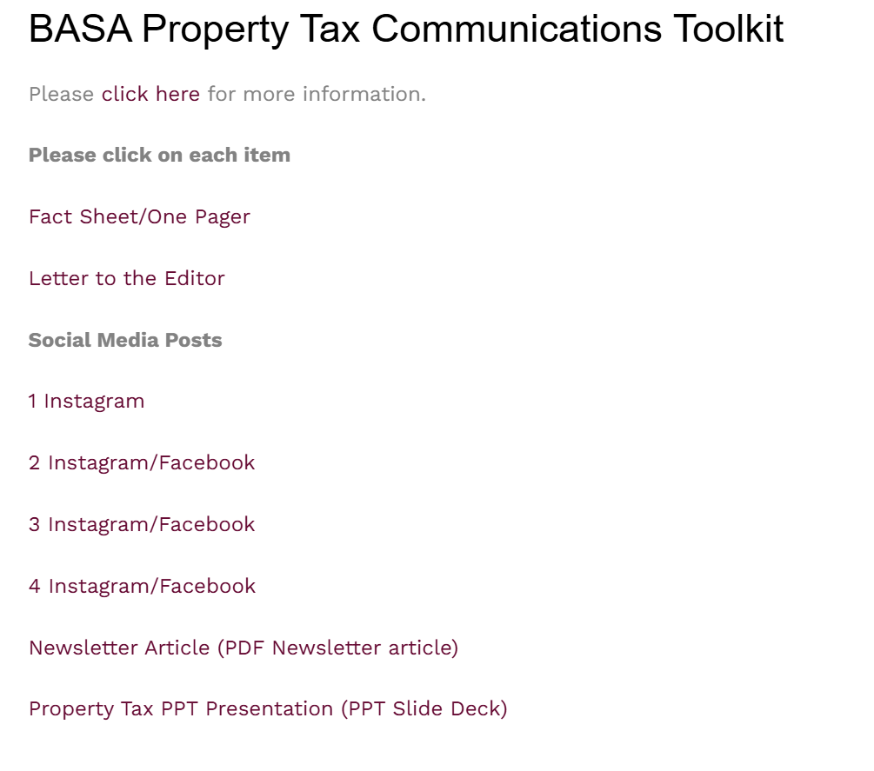

Slide 46


Slide 47


Slide 48
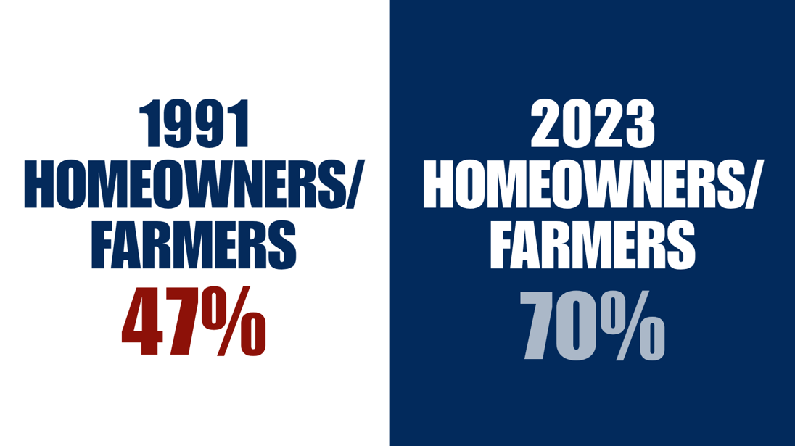

Slide 49
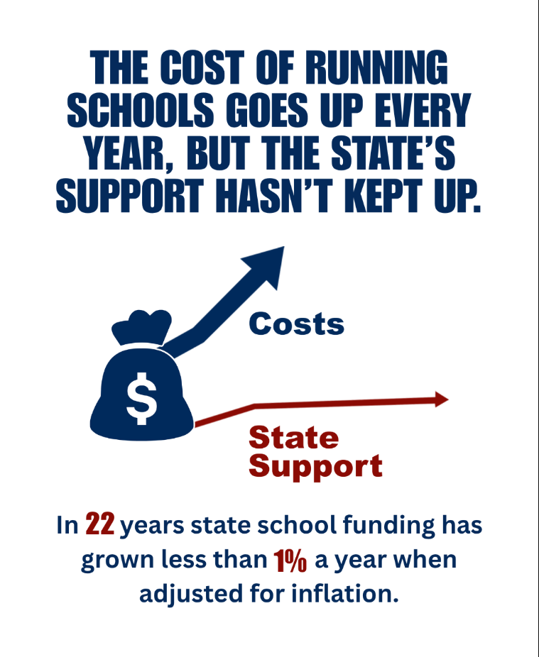

Slide 50
QUESTIONS and
OTHER ITEMS

Slide 51



Contact Information
Axner@basa-ohio.org
Imhoff@basa-ohio.org
(O) 614.846.4080
@BASA_Supt

